Slide 1
Violence Against Women
Alison Yao
Oscar Bray

Slide 2

Table of Contents
Introduction & Background
Research Questions
Data Analysis
Limitations
Conclusion & Future Work

Slide 3
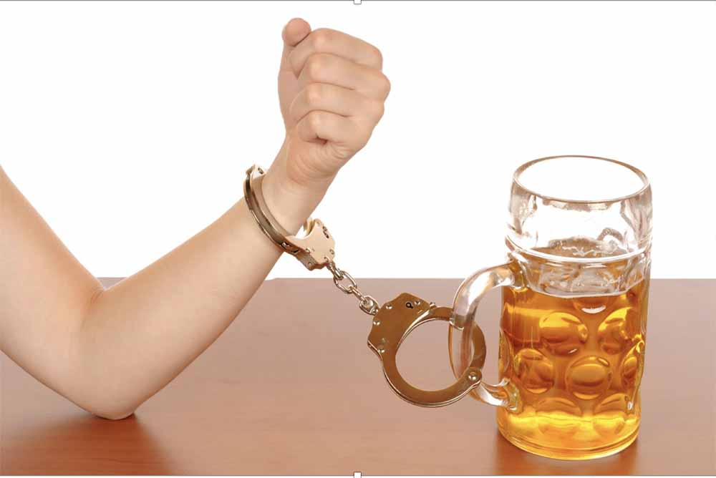
Introduction & Background
Possible contributors to VAW
GDP/economy
Women’s power (politics, domestic)
Alcohol
Common sense: alcohol induces violent behavior
Lots of research, lots of gaps
Contradictions (is it universal?)
Culturally homogenous
Victim vs perpetrator
Man vs woman?
Outdated
Small sample sizes
Notes:
‘Refining the Brustrokes in Portraits of Alcohol and Wife Assaults’

Slide 4
Research Question
How does alcohol use appear to affect the prevalence of violence against women?
Alcohol
Using data across multiple cultures
Prevalence
Individual incidents, seemed more likely to correlate
Extension: alcohol policies? (eg alcohol affordability)
We thought there would be a positive correlation.

Slide 5


Data Analysis - Data
Data Source: 2019 OECD study of violence against women
Attitudes toward violence: The percentage of women who agree that a husband/partner is justified in beating his wife/partner under certain circumstances
Prevalence of violence in the lifetime: The percentage of women who have experienced physical and/or sexual violence from an intimate partner at some time in their life
Laws on domestic violence: Whether the legal framework offers women legal protection from domestic violence Laws on domestic violence are presented as values ranging from 0 to 1, where 0 means that laws or practices do not discriminate against women’s rights and 1 means laws or practices fully discriminate against women’s rights.
Attitude (%)
0
100
Prevalence (%)
0
100
Law
0
1
We expect a positive correlation.

Slide 6
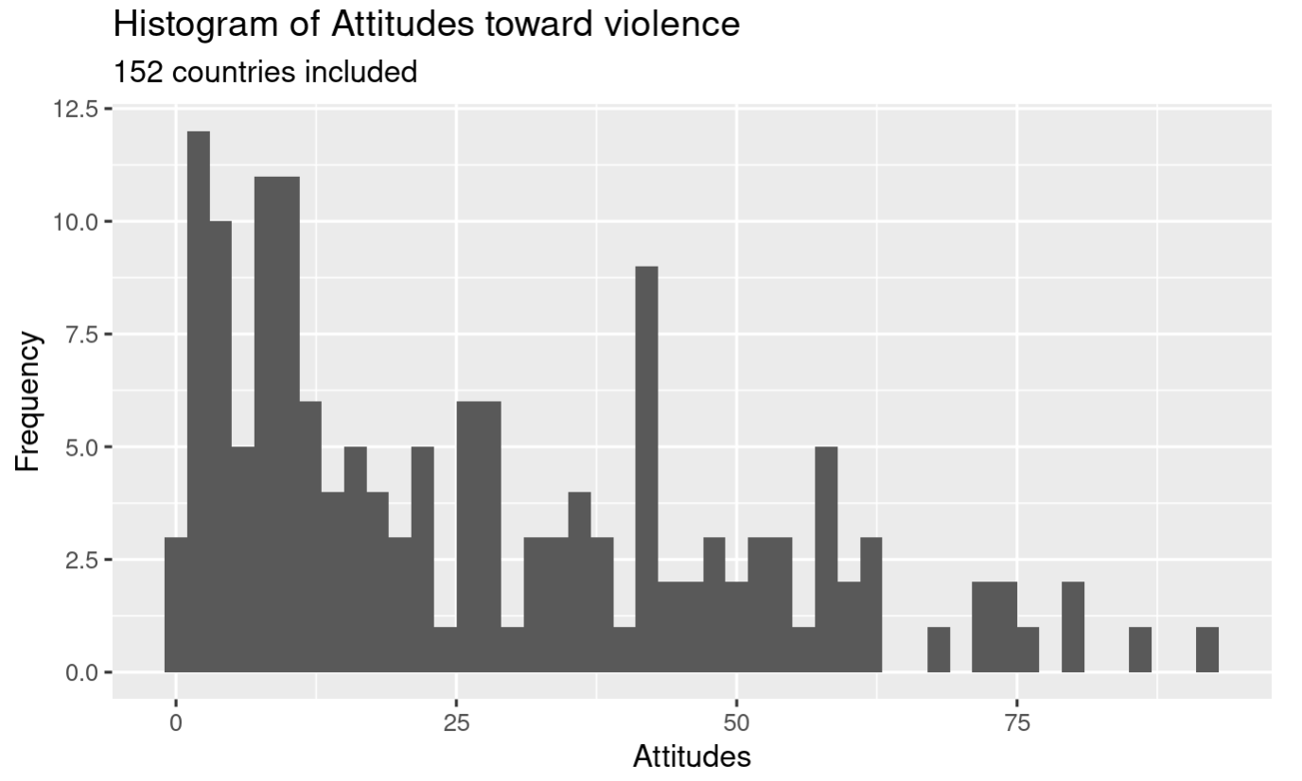
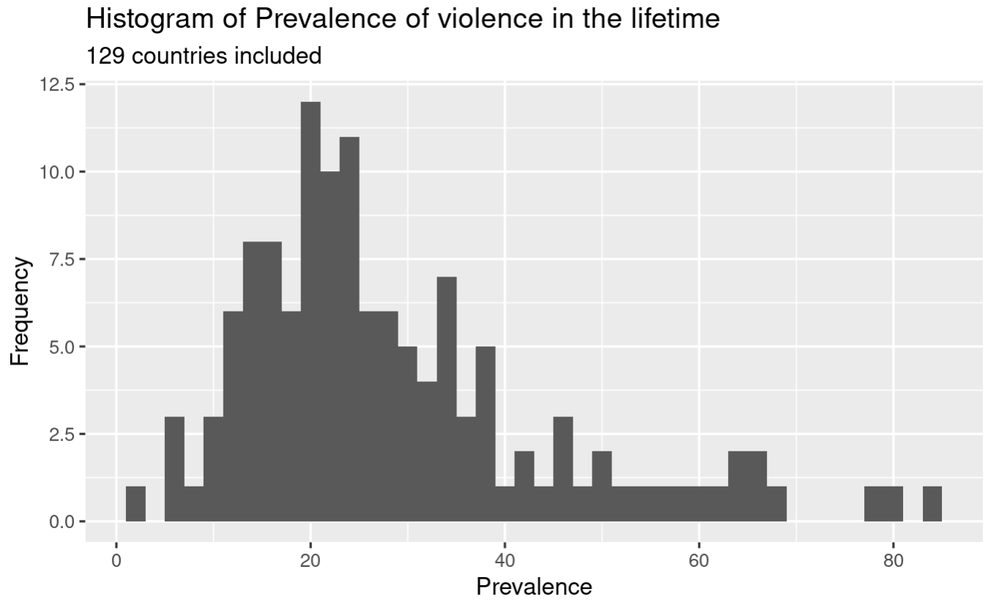
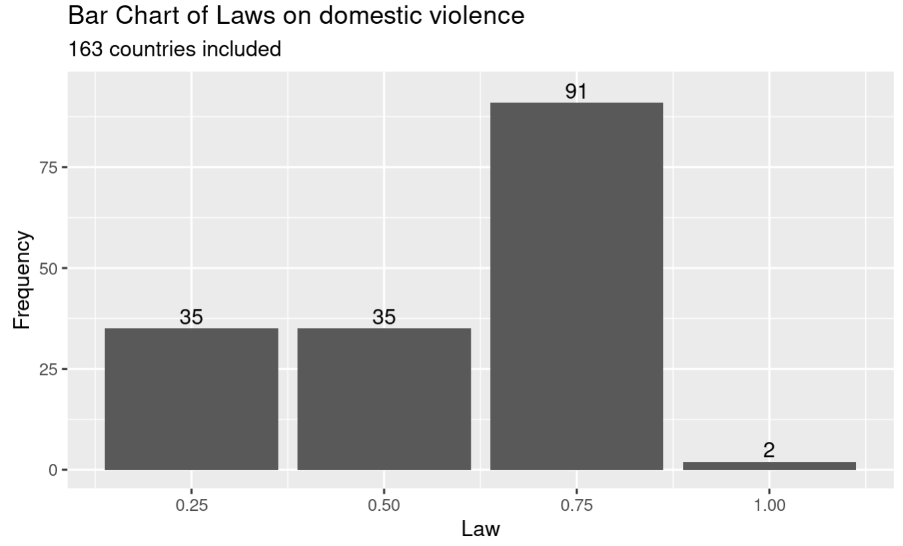
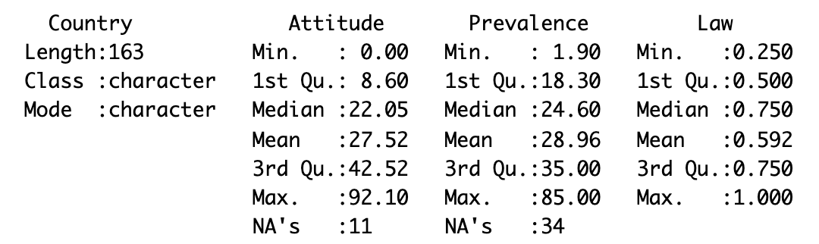
Data Analysis - Visualization
Data Source: 2019 OECD study of violence against women
Categorical
Imbalance

Slide 7
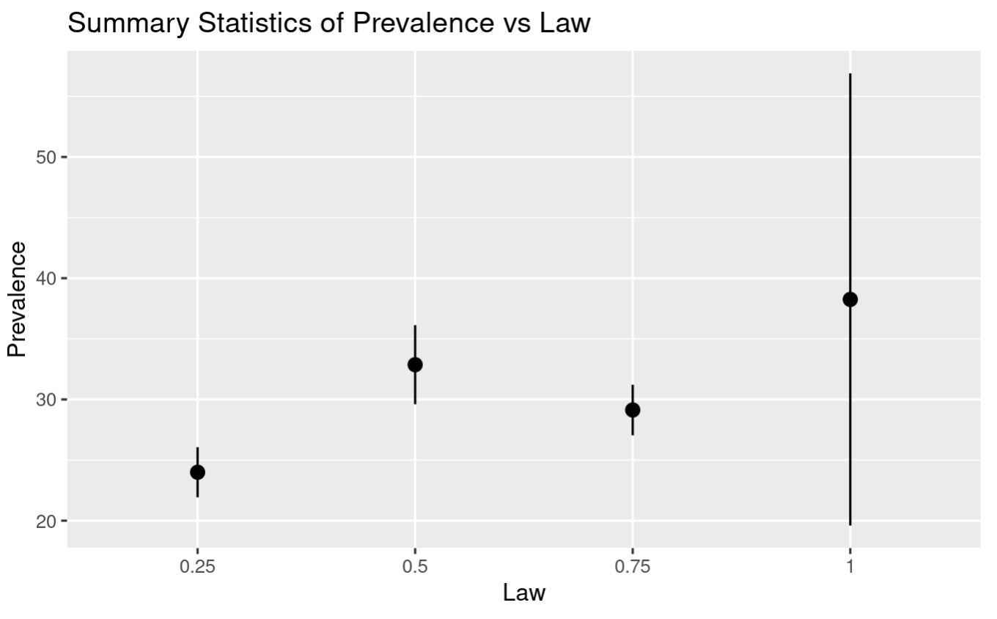
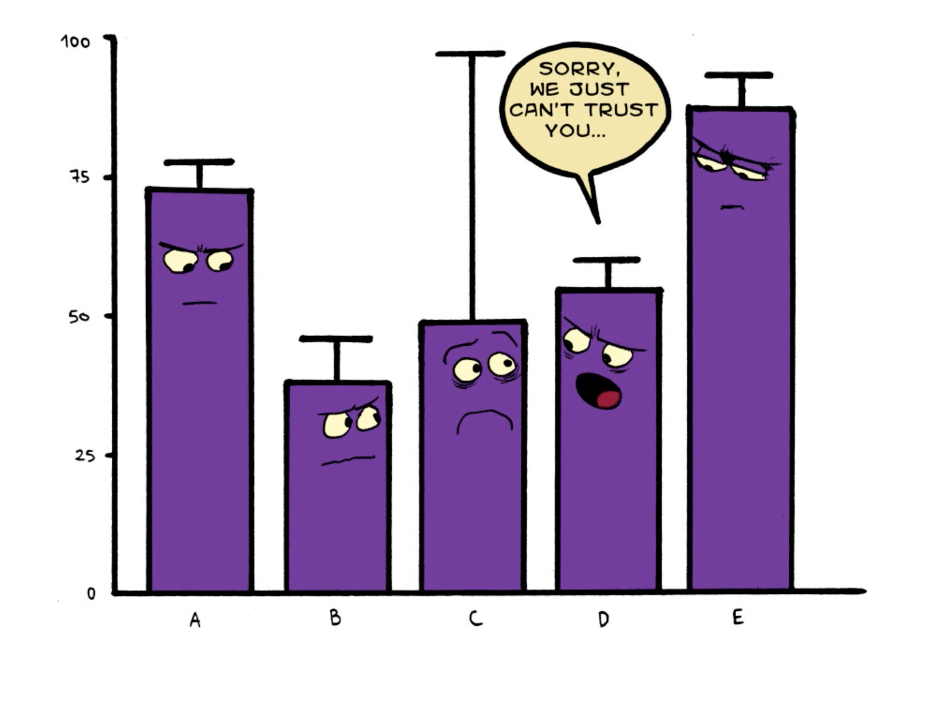
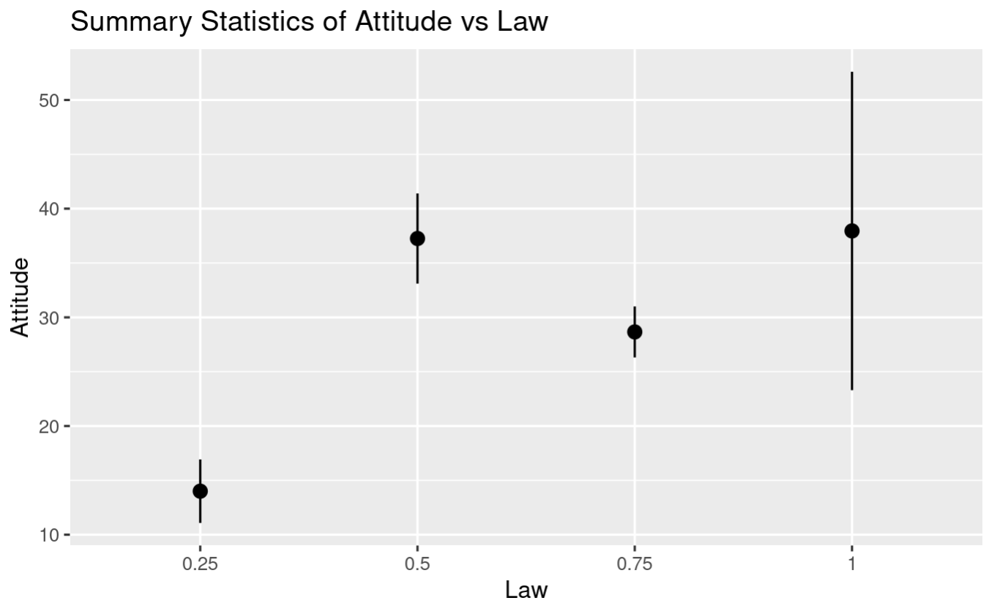
Data Analysis - Visualization
Data Source: 2019 OECD study of violence against women

Slide 8
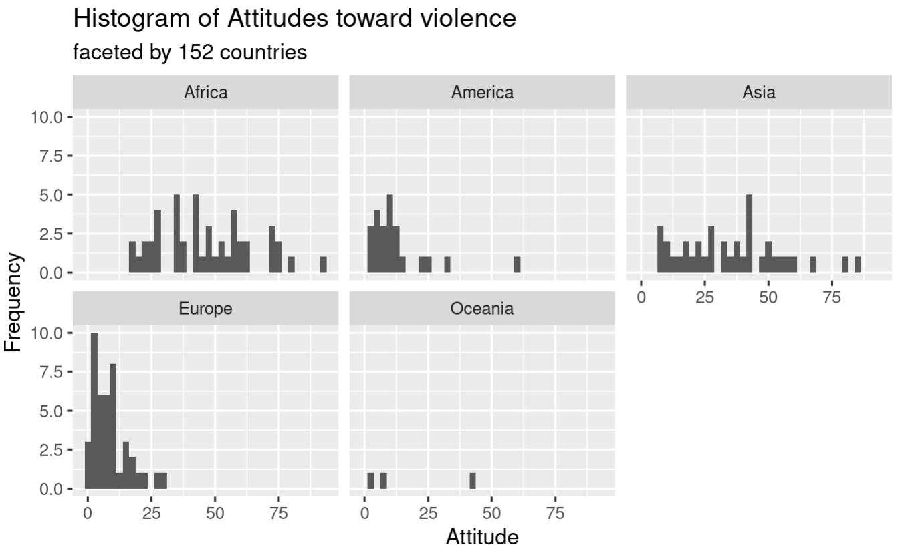
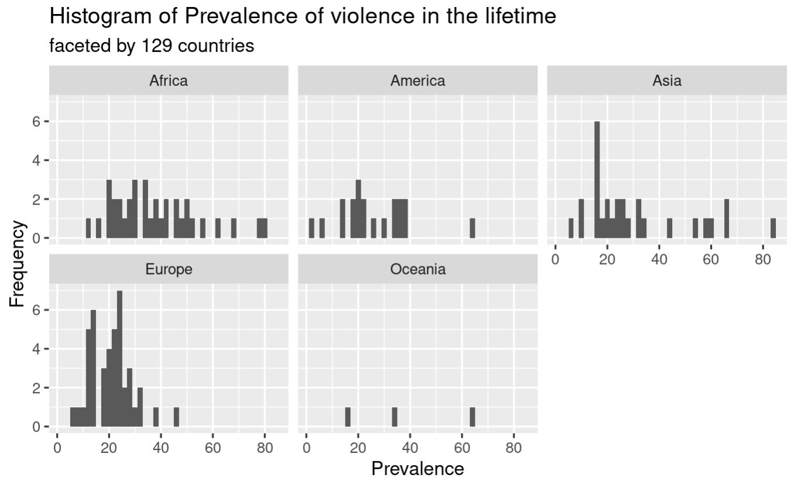
Data Analysis - Visualization
Data Source: Lab06 (Covid)

Slide 9
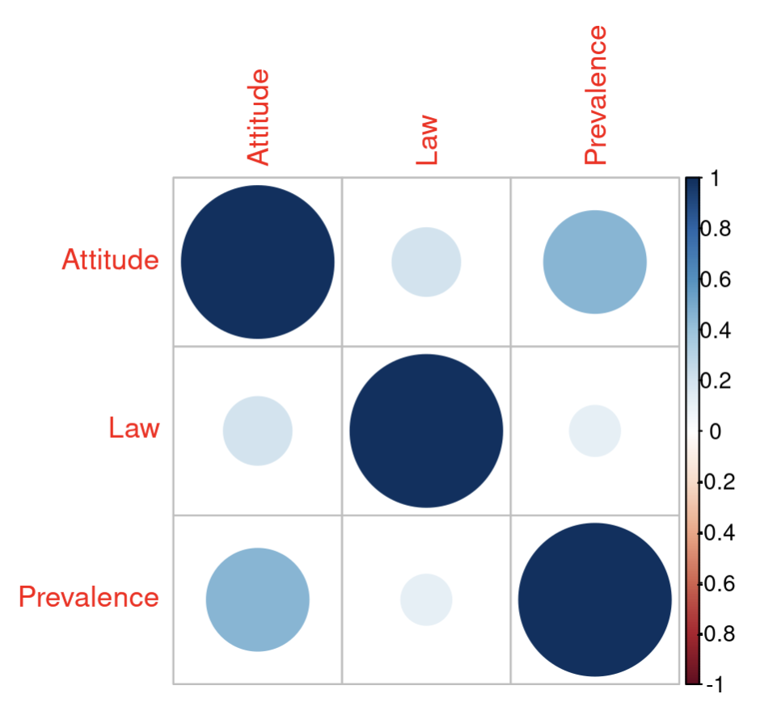
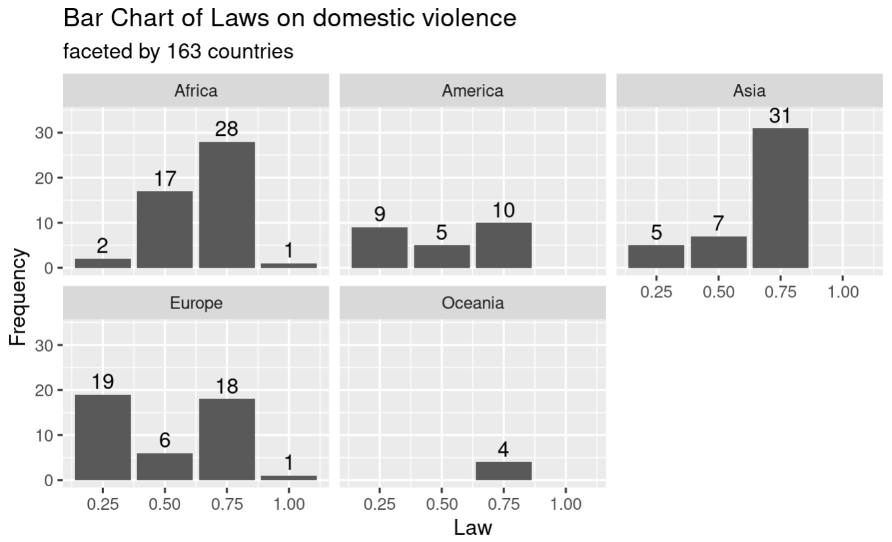
Data Analysis - Visualization
Data Source: Lab06 (Covid)
1.0
0.196
0.449
0.196
1.0
0.11
0.449
0.11
1.0
Bimodal

Slide 10
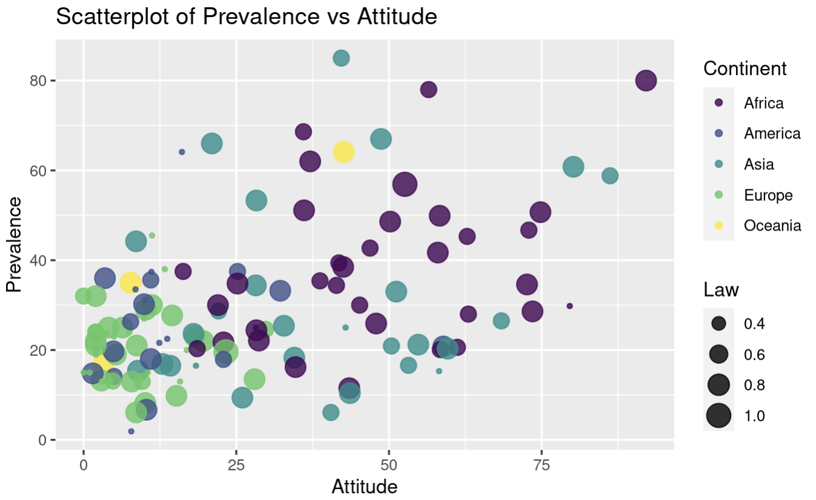
Data Analysis - Visualization
Guinea

Slide 11
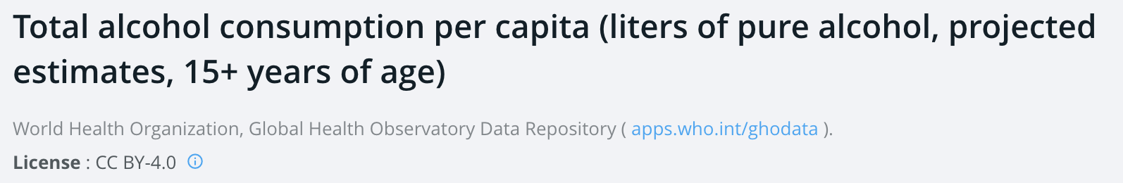
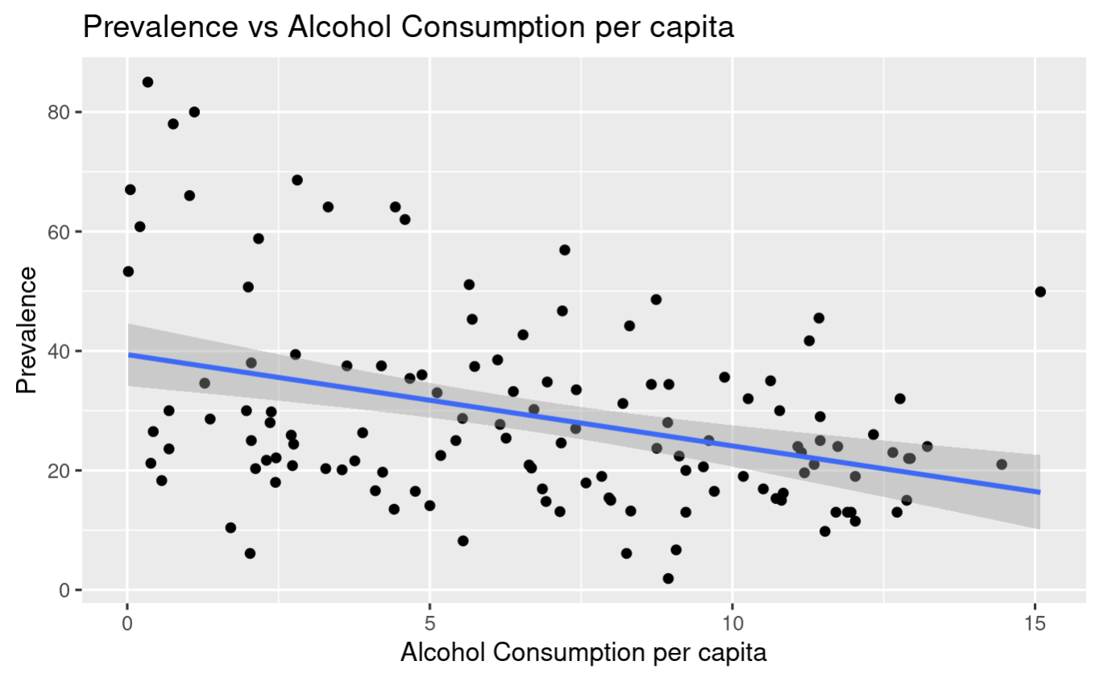
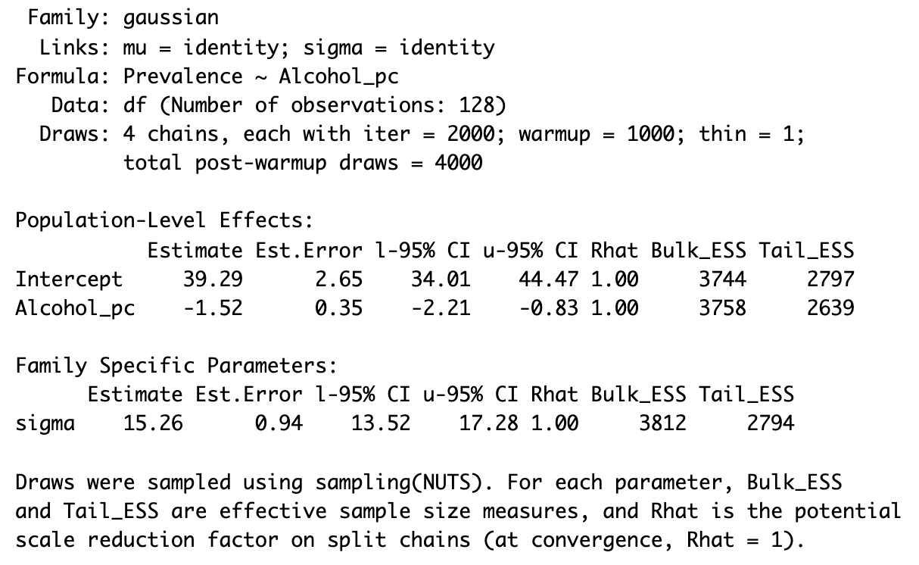
Data Analysis - Regression
Data Source: The World Bank

Slide 12
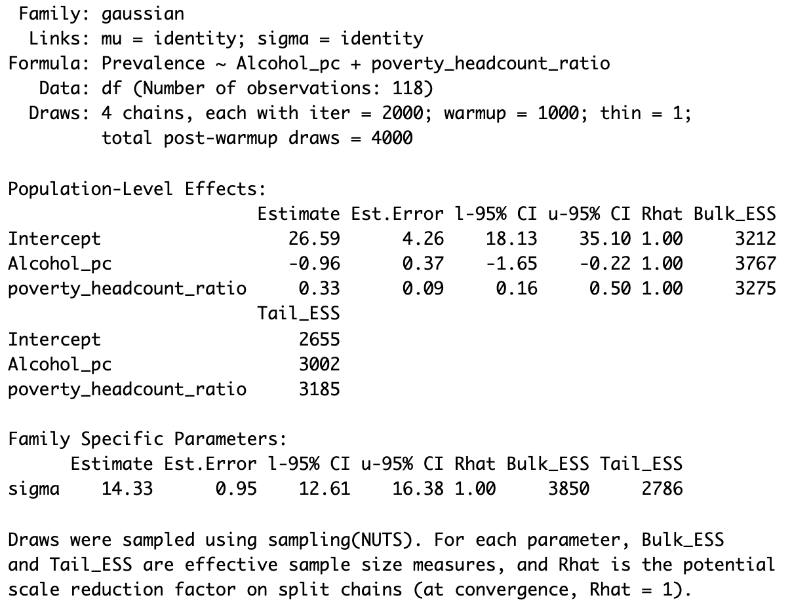
Data Analysis - Regression
Data Source: The World Bank
Percentage of the population living below the national poverty line
Compared to the earlier estimate, including poverty_headcou nt_ratio reduced the size of the association by about one-third, or about 33% decrease.

Slide 13
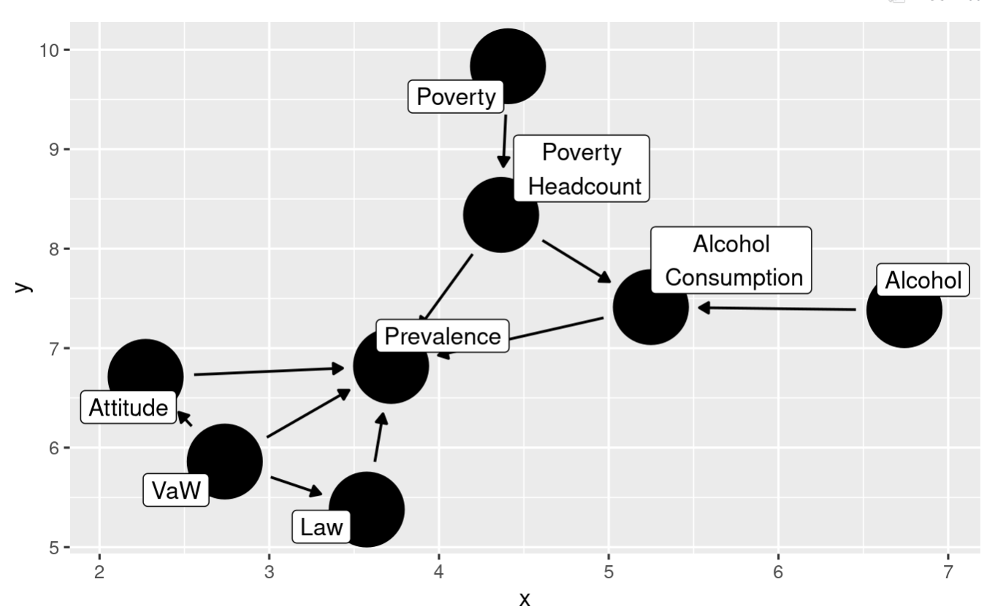
Data Analysis - Causal Diagram
Notes:
Layers: big problem, indicators, prevalence
Poverty headcount -> prevalence is speculative but reasonable
Attitude/prevalence link is the strongest

Slide 14

Limitations
Datasets
Fewer recent figures (COVID?)
Different levels of recency
Alcohol consumption
Liters of pure alcohol
Who is consuming? What is the distribution?
Other measures
‘Projected estimates’: how much?
Our analysis: gender? Victim vs perpetrator?
Multiple measures of poverty
Poverty lines ($3.20, $1.50 etc)
Varies depending on the country
More holistic picture (Gini index)
Notes:
Alcohol: most recent 2018
Prevalence: most recent 2019
Poverty headcount: a fucking mess

Slide 15
Conclusion & Future Work
More research is needed! (surprise surprise…)
May need to think of other potential measures of alcohol consumption
Poverty is a major variable
But wait! There’s more!
Notes:
Alcohol consumption
Surveys on alcohol use per week: advantages (localized results) and disadvantages (less reliable)
What’s more?
Gender and victim vs perpetrator
There are other confounding variables (coefficient isn’t zero)
Is alcohol correlated with attitude?

Slide 16
Thank you!
Q&A

